Slide 1
Presence in the World

Slide 2
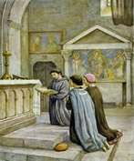
People:
Living the Good News of the Gospel
Art 18. 1 & 4 GC
Rule 6
Art. 17.1 GC
Admonition VII.I

Slide 3
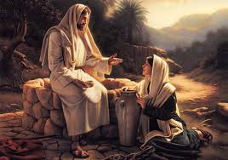
Reaching:
out in love
Rule 11
Art. 15.1 GC

Slide 4
Reaching out National level
Project Adoption was initiated at least 40 years ago by the Secular Franciscans in Australia.
Funding supports 2 major projects.

Slide 5
In 2016, 85 families were supported through the Franciscan Family Apostolate in the Diocese of Irinjalakuda, Kerala India.
The money was used for urgent necessities including food and drinking water, medical treatment, education of children and house repairs etc.

Slide 6
2. Alphonsa House is a boarding school for girls with severe disabilities who have been abandoned because of poverty.
Over the years money has been used to purchase a bus, medication and specialised educational equipment.

Slide 7
Reaching out Regional and local fraternities support
An orphanage in the Philippines run by the Franciscan Sisters of St Anthony
The work of the Poor Clares in Bosnia, Croatia and the Philippines
The Franciscan Mission in Papua New Guinea
The work done by Sr Lourdes, Mana Lou in Timor-Leste
The work done by the Franciscan Sisters of the Heart of Jesus in Brazil
Support the Franciscan Missionary of Mary Apostolate in Uganda
Financial support for the building of wells in Africa

Slide 8
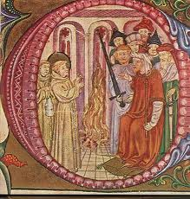
Evangelisation:
called to build a more fraternal and evangelical world
Rule 14
Art. 20.1 GC

Slide 9
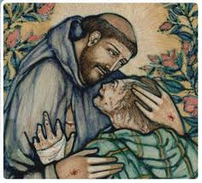
Seeking:
the lost and downtrodden of this world
Rule 13
Art. 18.2 & 3 GC

Slide 10
Seeking the poor and downtrodden local fraternities across Australia
Includes -
Involvement in the work of St Vincent de Paul
Vinnies Night Patrol – feeding the homeless
David’s Place - feeding and supporting the downtrodden of society
Support the work of the Missionaries of Charity sisters by
feeding the homeless and destitute including Aboriginal communities
Penola House – supports refugee families
etc

Slide 11
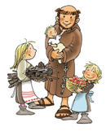
Educating:
the children
Rule 17
Art.24.1 GC

Slide 12
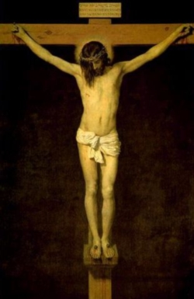
Noticing:
inequality and injustice
Rule 15
Art. 22 GC

Slide 13
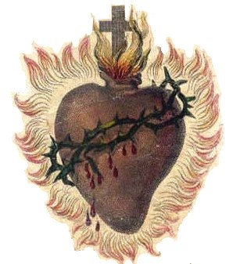
Charism:
of Christ
Rule 19
Art. 23.1 GC

Slide 14
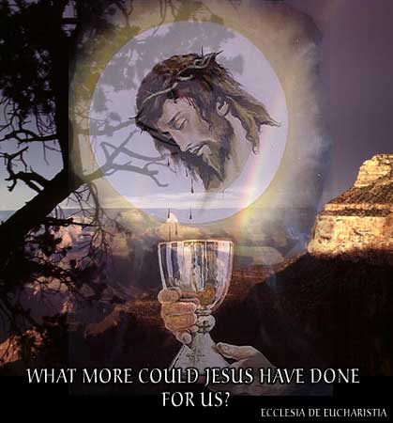
Eucharist:
the centre of our lives
Rule 8
Art. 14.1-5

Slide 15
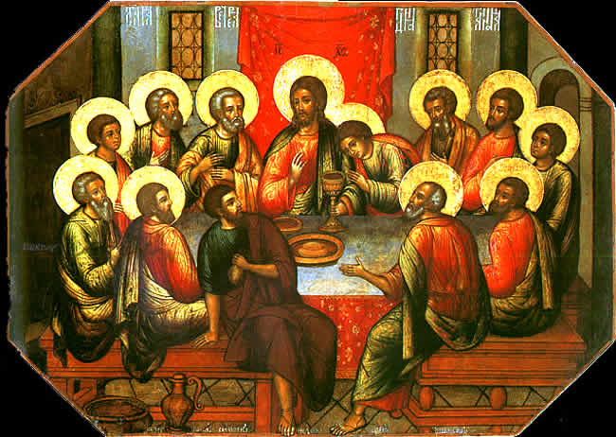
IN THE
Wonder: at the gift of Himself
Rule 10
Art. 10 GC

Slide 16
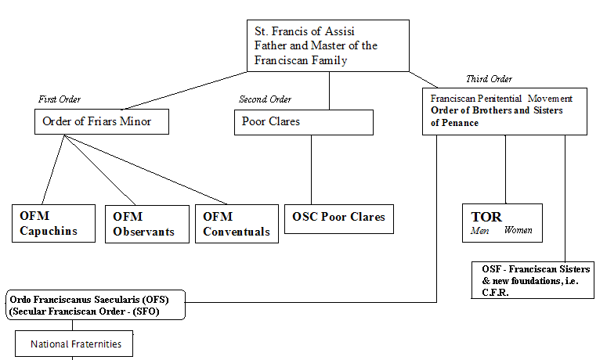
Order: we are an Order
Rule 20
Art. 28 GC

Slide 17
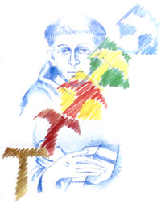
Radiating:
throughout the world
Art. 18 GC

Slide 18
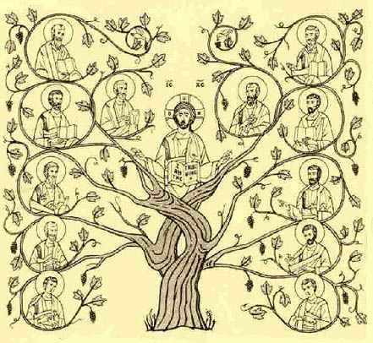
Love: one another
Rule 13
Admonition. IX.I

Slide 19
Doing: The Lord’s Will
Rule 7
Art. 13.1 GC

Slide 20
St. Francis of Assisi School Newton
“
Tau Crosses
At the Beginning of Year Mass our Year 7 students received a Franciscan Tau Cross necklace from the Secular Franciscan Order.

Slide 21
When I wear the cross I know it is very powerful and it is a symbol for me that has hidden messages in, it was St Francis of Assisi’s favourite thing and it shows that I am a person who loves God. Sarina
“You are a great inspiration for us. I am always going to wear it. It reminds me of the time when St Francis healed the man’s leg with the Tau. I know it was a big part of his life so I will make it a big part of mine.” John

Slide 22
“Thank you for the Tau. I like it because I’ve learnt a lot about it like it’s the symbol for youth.”Aguil
“ I am very grateful to have this gift. This Tau makes me feel one with God. It reminds me that I will have eternal life with God.” Joshua
“When I look at the Tau it reminds me of your kindness like what the cross is about. Now I can go around the world and everyone knows I’m Franciscan.” Clare

