Slide 1
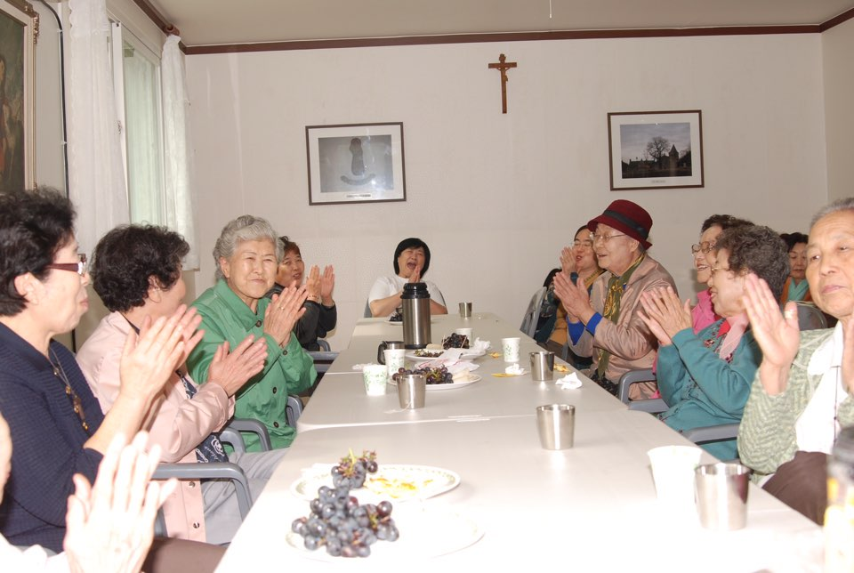
Catherine Lee, National Minister,
OFS Korea

Slide 2
1. OFS member statistics by age
Total: 13,764(2016):
Initial formation: 2,266
Permanently professed: 11,498
Average age: 68
> 65: 51.4%
Inquirors 2007-2016
<35 : 15% down; 50-65 : 25% up

Slide 3
Age Distribution: OFS Korea, 2016
1.17%
6.39%
44.1%
49.2%

Slide 4
Members on Formation by Age(2016)
(Initial Formation 2,266/ Ongoing Formation 11,498)
1.2%
0.05%
7.1%
3.76%
19.7%
51.4%
44.7%
72%
Ongoing: Average age: 68
Notes:
0.2%/

Slide 5
2. Aging: Korea vs. OFS Korea
2007-2016
Korea OFS > 65 : 19.8% up
Korea: > 65 : 35.3% up
Aging rate of Korea OFS: 15.5% lower due to constant efforts
However aging of the Fraternity is still going on.
3. Reasons for Fraternity Aging
Candidates’ age is getting older
Younger Catholics are too busy with parish or family works to join OFS.
Younger Catholics feel reluctant to be with old members.

Slide 6
4. Problems:
difficult to find those who serve for the fraternity
The elderly to be served serve for the fraternity.
difficult to carry out apostolic or JPIC activities
5. Efforts to Deal With Aging Fraternity
to introduce those under 50 to OFS vocation
To strengthen vocation discernment
to introduce YouFra to OFS
To hold retreats for young members to foster vocation

Slide 7
6. Results of the Efforts
The increase rate of aging has been slow.
(the number >65 stays 50%)
Admittance of YouFra into OFS has increased.
having frequent meetings and visiting them
sending Fraternity news letters & <Apostolate of Peace>
providing rides to fraternity meetings and asking for prayer activities
Group Home Project for elderly members has started by Regions. Two Regions have been operating Nursing Homes for elderly members for over 30 years.
7. Efforts to take care of elderly members
Notes:
0.2%/

