Slide 1
Presence in the World

Slide 2
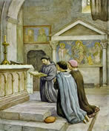
People:
Living the Good News
of the Gospel
Rule 6
Art. 17.1 GC
Admonition VII.I
Notes:
P) People living the good news of the Gospel in the manner of St Francis in the world under the guidance of the Holy Spirit.
Rule 6: They have been made living members of the Church by being buried and raised with Christ in baptism; they have been united more intimately with the Church by profession. Therefore, they should go forth as witnesses and instruments of her mission among all people, proclaiming Christ by their life and words.
Called like St Francis to rebuild the Church and inspired by his example, let them devote themselves energetically to living in full communion with the pope, bishops, and priests, fostering an open and trusting dialogue of apostolic effectiveness and creativity.
(Also Art 17:1 and Admonition V11:1)

Slide 3
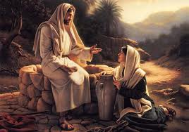
Reaching:
out in love
Rule 11
Art. 15.1 GC
Notes:
R) Reaching out in love to those around us, our families, work colleagues, Parish, but especially the poor and unloved of the world. eg orphanages in India and the Philippines.
Rule 11: Trusting in the Father, Christ chose for Himself and His mother a poor and humble life, even though He valued created things attentively and lovingly. Let the Secular Franciscans seek a proper spirit of detachment from temporal goods by simplifying their own material needs. Let them be mindful that according to the gospel they are stewards of the good s received for the benefit of God’s children.
Thus, in the spirit of “the Beatitudes,” and as pilgrims and strangers on their way to the home of the Father, they should strive to purify their hearts from every tendency and yearning for possession and power.
(Also Art 15:1)

Slide 4
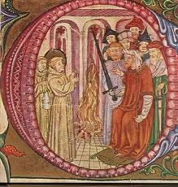
Evangelisation: called to build a more fraternal and evangelical world.
Rule 14
Art. 20.1 GC
Notes:
E) Evangelisation – each one of us is called to build a more fraternal and evangelical world.
Rule 14: Secular Franciscans, together with all people of good will, are called to build a more fraternal and evangelical world so that the kingdom of God may be brought about more effectively. Mindful that anyone “who follows Christ, the perfect man, becomes more of a man himself,” let them exercise their responsibilities competently in the Christian spirit of service.
(Also Art 20:1)

Slide 5
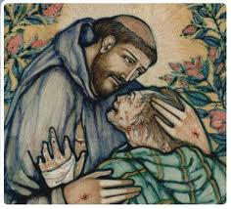
S eeking:
the lost and downtrodden of this world
Rule 13
Art. 18.2 &.3 GC.
Notes:
S) Seeking those who are the lost and downtrodden of this world. eg by being involved in the ‘Society of St Vincent de Paul’ (the founder of the Society of St Vincent de Paul Frederick Ozanam was himself a Third Order Franciscan) and ‘40 Days for Life’.
Rule 13: As the Father sees in every person the features of His Son, the firstborn of many brothers and sisters, so the Secular Franciscans with a gentle and courteous spirit accept all people as a gift of the Lord and an image of Christ.
A sense of community will make them joyful and ready to place themselves on an equal basis with all people, especially with the lowly for whom they shall strive to create conditions of life worthy of people redeemed by Christ.

Slide 6
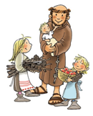
E ducating:
the children
Rule 17
Art.24.1
Notes:
E) Educating the children that we meet, about the spirit of St Francis and his love of the Lord. eg Newton Parish School.
Rule 17. In their family they should cultivate the Franciscan spirit of peace, fidelity and respect for life, striving to make of it a sign of the world already renewed in Christ. By living the grace of matrimony, husbands and wives in particular should bear witness in the world to the love of Christ for His Church. They should joyfully accompany their children on their human and spiritual journey by providing a simple and open Christian education and being attentive to the vocation of each child.
(Also Art. 24.1)

Slide 7
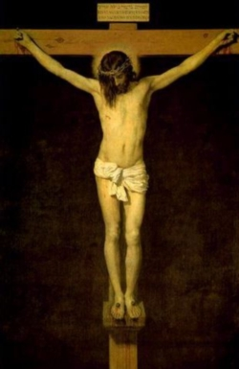
Noticing: inequality and injustice
Rule 15
Art. 22 GC
Notes:
N) Noticing the inequality and injustice around us. Responding in any way we can to bring about equality. eg Franciscan calendar/prayer cards are sent to our State Politicians and local Councillors.
Rule 15: Let them individually and collectively be in the forefront in promoting justice by the testimony of their human lives and their courageous initiatives. Especially in the field of public life, they should make definite choices in harmony with their faith.
(Also Art 22)

Slide 8
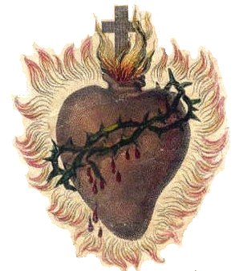
C harism:
of Christ
Rule 19
Art. 23 GC
Notes:
C) Charism of Christ giving His love, peace and joy to the world, that only He can give. We must allow Him to work in us to spread this to the world.
Rule 19: Mindful that they are bearers of peace which must be built up unceasingly, they should seek out ways of unity and fraternal harmony through dialogue, trusting in the presence of the Divine Seed in everyone and in the transforming power of love and pardon.
Messengers of perfect joy in every circumstance, they should strive to bring joy and hope to others.
Since they are immersed in the resurrection of Christ which gives true meaning to Sister Death, let them serenely tend toward the ultimate encounter with the Father.
(Also Art 23)

Slide 9
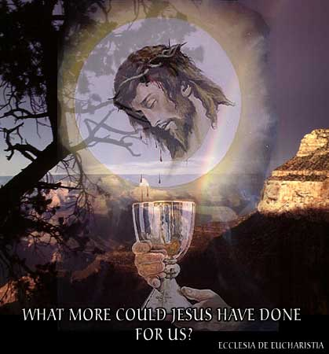
Eucharist:
the centre of
our lives
Rule 8
Art. 14.1-5
Notes:
E) Eucharist is to be the centre of our lives as it was for St Francis. It gives us the strength, trust and hope to reach out to others. We are united to our Christ and become one body.
Rule 8: As Jesus was the true worshipper of the Father, so let prayer and contemplation be the soul of all they are and do.
Let them participate in the sacramental life of the Church, above all the Eucharist. Let them join in liturgical prayer in one of the forms proposed by the Church, reliving the mysteries of the life of Christ.
(Also Art 14:1-5)

Slide 10
IN THE

Slide 11
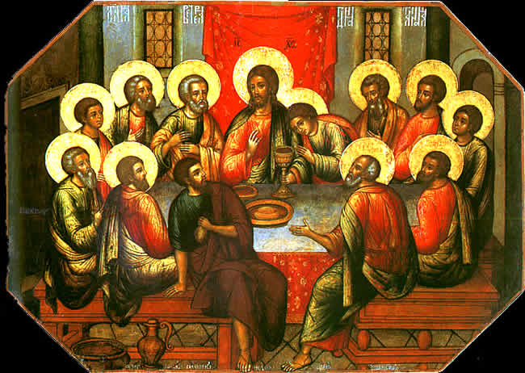
Wonder:
at the gift of Himself
Rule 10
Art. 10 GC
Notes:
W) Wonder at the gift of Himself that our loving Lord gave on the Cross to bring each one of us to freedom. Each one of us is also asked to willingly endure suffering, insults and humiliation in our lives with patience. EG our daily crosses or hardships or illnesses.
Rule 10: United themselves to the redemptive obedience of Jesus, who placed His will into the Father’s hands, let them faithfully fulfil the duties proper to their various circumstances of life. Let them also follow the poor and crucified Christ, witness to Him even in difficulties and persecutions.
(Also Art 10)

Slide 12
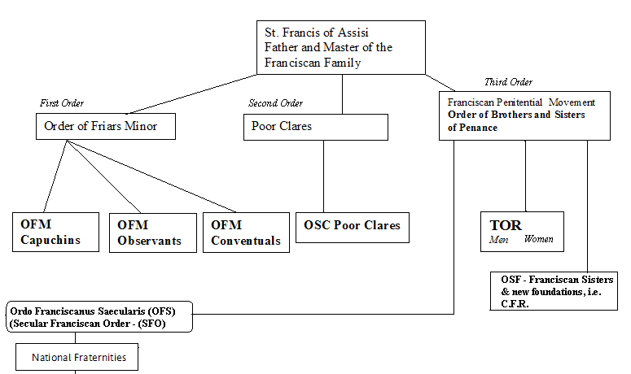
Order:
we are an Order
Rule 13
Art. 18.2 & 3 GC
Notes:
O) Order – we are a Secular Order (a true Order which constitutes a school of complete Christian perfection) and each one of us at the time of our Profession, is called to live our vocation in the Secular World.
Rule 13: As the Father sees in every person the features of His Son, the firstborn of many brothers and sisters, so the Secular Franciscans with a gentle and courteous spirit accept all people as a gift of the Lord and an image of Christ.
A sense of community will make them joyful and ready to place themselves on an equal basis with all people, especially with the lowly for whom they shall strive to create conditions of life worthy of people redeemed by Christ.
(Also art 18:2.3.)

Slide 13
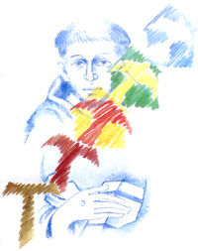
Radiating:
throughout the world
Rule 20
Art. 28.2
Notes:
R) Radiating throughout the world. Each fraternity brings its own uniqueness to those around them.
Rule 20: The Secular Franciscan Order is divided into fraternities of various levels – local, regional, national, and international. Each one has its own moral personality in the Church. These various fraternities are coordinated and united according to the norm of this rule and of the constitutions.
(Also Art 28:2)

Slide 14
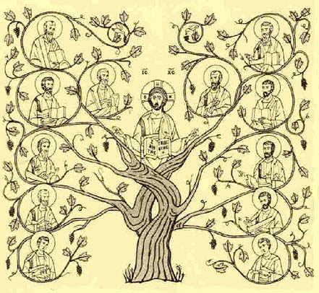
Love:
one another
Rule.13
Admonition. IX.I
Notes:
L) Love – “I give you a new commandment: love one another; just as I have loved you, you also must love one another. By this love you have for one another, everyone will know that you are my disciples”. (John 13: 34-35)
Rule 13: As the Father sees in every person the features of His Son, the First Born of many brothers and sisters, so the Secular Franciscans with a gentle and courteous spirit accept all people as a gift of the Lord and an image of Christ.
(Admonition 1X:1)

Slide 15
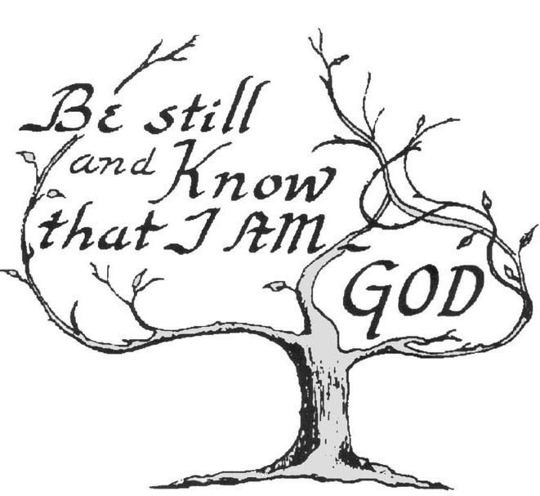
Doing:
The Lord’s Will
Rule 7
Art. 13.1 GC
Notes:
D) Doing the Lord’s will in our lives, answering His call by living out our Franciscan Vocation. “ What is good has been explained to you man; this is what God asks of you: only this, to act justly, to love tenderly and to walk humbly with your God. (Micah 6:8)
Rule 7: United by their vocation as “brothers and sisters of penance”, and motivated by the dynamic power of the gospel, let them conform their thoughts and deeds to those of Christ by means of that radical interior change which the gospel itself calls “conversion.” Human frailty makes it necessary that this conversion be carried out daily.
On this road to renewal the sacrament of reconciliation is the privileged sign of the Father’s mercy and the source of grace.
(Also Art 13:1)

Slide 16
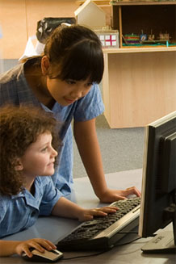
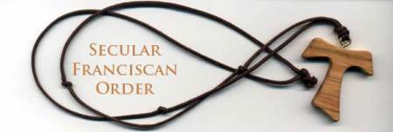
St. Francis of Assisi School
Newton South Australia
Tau Crosses
At the Beginning of Year Mass our Year 7 students received a Franciscan Tau Cross necklace from the Secular Franciscan Order. Lola Kelly sfo, the Minister of the Newton Fraternity presented the gift to our new student leaders.
“When I wear the cross I know it is very powerful and it is a symbol for me that has hidden messages in, it was St Francis of Assisi’s favourite thing and it shows that I am a person who loves God. Sarina 7AE
“You are a great inspiration for us. I am always going to wear it. It reminds me of the time when St Francis healed the man’s leg with the Tau. I know it was a big part of his life so I will make it a big part of mine.” John Hayek 7AE
“Thank you for the Tau. I like it because I’ve learnt a lot about it like it’s the symbol for youth.”Aguil 7AE
“ I am very grateful to have this gift. This Tau makes me feel one with God. It reminds me that I will have eternal life with God.” Joshua 7AE
“When I look at the Tau it reminds me of your kindness like what the cross is about. Now I can go around the world and everyone knows I’m Franciscan.” Clare 7AE
Notes:
HOW DOES OUR NEWTON FRATERNITY MAKE A PRESENCE IN THE WORLD?
We reach out to the Newton Parish School, by presenting year 7 students, who are the school leaders, with Tau Crosses and booklets at the beginning of the school year and with San Damiano Cross and booklet, as they leave the school at the end of the year. The students respond by enquiring further into the Tau Cross and even looking into the Secular Franciscan way of life. They have also expressed their gratitude to us in writing.
The year 7 students also assist the SFO in providing refreshments, after every Mass of Anointing held in the parish church.
The year 4 students are given a booklet of short stories eg Wolf of Gubbio. We also become ‘prayer buddies’ for the year 4 students as they prepare to receive the Sacraments.
Many of the Fraternity attend School Masses and I attend the Teacher’s Days of Reflection at which I give a short talk on the SFO.
By supporting orphanages: in India through Project Adoption and the Philippines directly through the Franciscan Sisters of St Anthony.
We present a San Damiano Cross (with booklet of explanation) to the newly Baptised adults and to those who have just been received into the Catholic Church at Newton Parish at Easter.
THE RESULT OF OUR INPUT INTO THE SCHOOL COMMUNITY
The Religious Co-ordinator of the school writes: “the Secular Franciscans have been influential in the lives of our students through various activities, their presence and their gifts which become a focus to support the development of Franciscan spirituality. Further the Secular Franciscans have an influence on the lives of our staff and our adult community through the presence they have at significant events.
We are at a point in our relationship that it is second nature to consider involving or seeking assistance from the Secular Franciscans when we are considering community activities, which seek to further our religious identity, our faith.
It is through these activities that our whole school community
benefit by having a group of people who are interested in what we do and how we do it. They show their interest in being on our journey through life with us.
This support helps us also to develop an understanding of our Franciscan spirituality and our ability to form a relationship with Christ which brings joyful hope to our very nature.”
Here are some articles taken from our school newsletter.

Slide 17
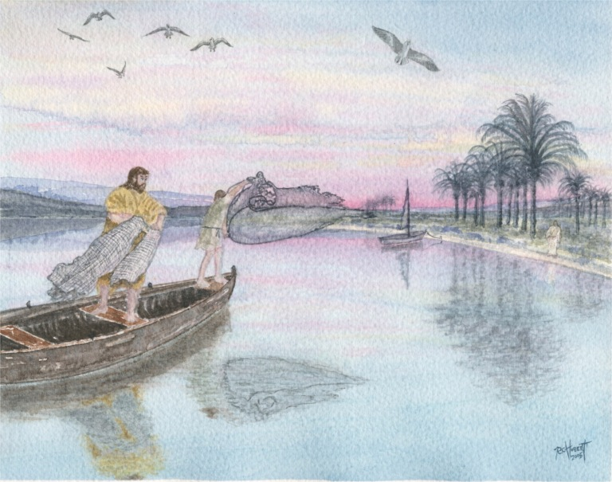
Where
are
you
casting
your
nets?

