Slide 1
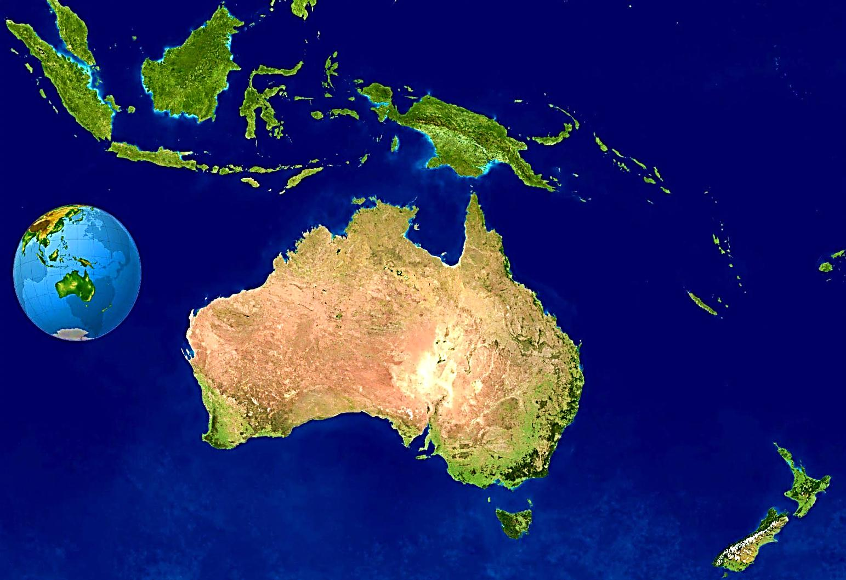
OFS NATIONAL FRATERNITY OF OCEANIA

Slide 2
Oceania consists of four Nations Australia Papua New Guinea Singapore Sabah

Slide 3
7 Regional Fraternities 37 Local Fraternities (in Australia) 10 Local Fraternities (4 in Singapore 6 in Sabah) 5 Emerging Fraternities in Sabah 11 Fraternities in Papua New Guinea (not yet constituted as a Regional Fraternity)

Slide 4
Regions | Permanently Professed Members | Canon. Estab. Fraternities | Estab. Reg. Fraternities | Presence of Franciscan Youth | Those in Formation
NSW/ACT | 336 | 17 | 1 | 1 | 29
Victoria | 138 | 6 | 1 | 0 | 8
QLD | 108 | 3 | 1 | 0 | 3
TAS | 30 | 3 | 1 | 0 | 2
SA | 82 | 3 | 1 | 0 | 8
WA | 104 | 4 | 1 | 0 | 3
SING/SAB | 395 | 10 | 1 | 0 | 3
 |  | 5 Emerg. Sabah
OCEANIA | 1093 | 46 | 7 | 1 | 145

Slide 5
Implementation of Conclusions of General Chapter
Formation – 21-23 September 2012 National
Formators Workshop “ Forming the Formators”
Formation Seminars held in a number of Regional Fraternities
CIOFS Taiwan

Slide 6
COMMUNICATION International Councillor – all correspondence from CIOFS Report to National Council in May 2012 – impressions of General Chapter in Brazil Availability of Ongoing Formation Dossiers Presence in the World Commissions – monthly articles from CIOFS website Each member of National Executive assigned a Regional Minister for liaison The Oceania Newsletter – quarterly newsletter Regional Newsletters – exchange Conference of National Spiritual Assistants – Monthly Spiritual Message

Slide 7
Franciscan Youth
1 Franciscan Youth Fraternity constituted
Assistance from National Fraternity for members to attend the International Gathering of Franciscan Youth and World Youth Day

Slide 8
PRESENCE IN THE WORLD
National Apostolate – Project Adoption -40 yrs
Supporting the world’s poorest families in 2 diocese in Southern India – 243 families
JPIC through Bangkok Office of Franciscans International
Year 7 students (approx 12 yrs of age) presentation of Tau Crosses and booklets on the San Damiano Crucifix, Tau Cross & The Wolf of Gubbio
Presentation of San Damiano Crucifix to newly baptised adults and those received into the Catholic Church at Easter

Slide 9
EMERGING FRATERNITIES
Support of New Zealand National Fraternity
Emerging Regional Fraternities of Singapore and Sabah – National Fraternity of Malaysia/Singapore

Slide 10
CHALLENGES
Candidates for Election in July 2013
Difficult Working Relationships between some Regional Ministers & National Executive owing to revision of National Statutes.

Slide 11
SPIRITUAL ASSISTANCE
OFM – 8 Friar Assistants
Lay Spiritual Assistants – 9 appointed by the OFM
1 Secular Priest & 1 Deacon belong to OFS
1 Salesian priest
3 Franciscan Srs
1 Sister of Mercy
OFM.CAP – 5 Assistants
1 Franciscan Sister
OFM.CONV. – 5 Assistants
OFM Custos both in Papua New Guinea & Singapore appoint Spiritual Assistants in their countries

Slide 12
SPIRITUAL ASSISTANCE cont..
Papua New Guinea – OFM Friars 8 fraternities
1 in Port Morseby – South Coast
6 in Aitape – North Coast
1 in West New Britain, 1 in Lae – North Coast
Capuchins have 1 fraternity in Wabag- Central Highlands
1 MFIC Sister in Aitape and 1 in Madang

Slide 13
SPIRITUAL ASSISTANCE cont…
Singapore and Sabah
1 FMM Sister
2FMDM Sisters
9 FSIC Sisters
1 Friar Minor
OFM Friar Regional Assistant for Singapore
FSIC Sister Regional Assistant for Sabah
Capuchin Friar for West Malaysia

Slide 14
CONFERENCE OF NATIONAL ASSISTANTS OFS-OCEANIA
National Spiritual Assistant resigned in February 2013 due to health issues and work load.
Conference meets monthly
Conference delegates members to make pastoral visits to regional level
Makes decisions collegially re spiritual assistance to the OFS
Conference members also are delegated to various national committees

Slide 15
NATIONAL STATUTES
Have been amended
Await Approval by National Chapter in July 2013
and Promulgation by Presidency

Slide 16
COURSES FOR OFM FRIARS IN FORMATION
Guidelines for the Formation of Friars for Understanding and Assisting the SFO
Published by the Conference of General Assistants 1992 is posted on the OFM Province’s website http://www.franciscans.org.au
Add /sfo/sfo19/19.htm for Postulants and
/sfo/sfo8/8/htm for Novices and
/sfo/sfo15/postnov.htm for Junior Professed Friars

Slide 17
COURSES FOR THE FORMATION OF SECULAR FRANCISCANS AS SPIRITUAL ASSISTANTS
6 Secular Franciscans and 1 Franciscan Sister
None appointed as yet
2 Secular Franciscans are currently following the course “Franciscan Family Connections”
Revised Edition 2011

Slide 18
WEB SITES
National Fraternity OFS-Oceania
http://www.secularfranciscansoceania.com.au
OFM National Spiritual Assistant
http://www.franciscans.org.au/sfo

