Slide 1
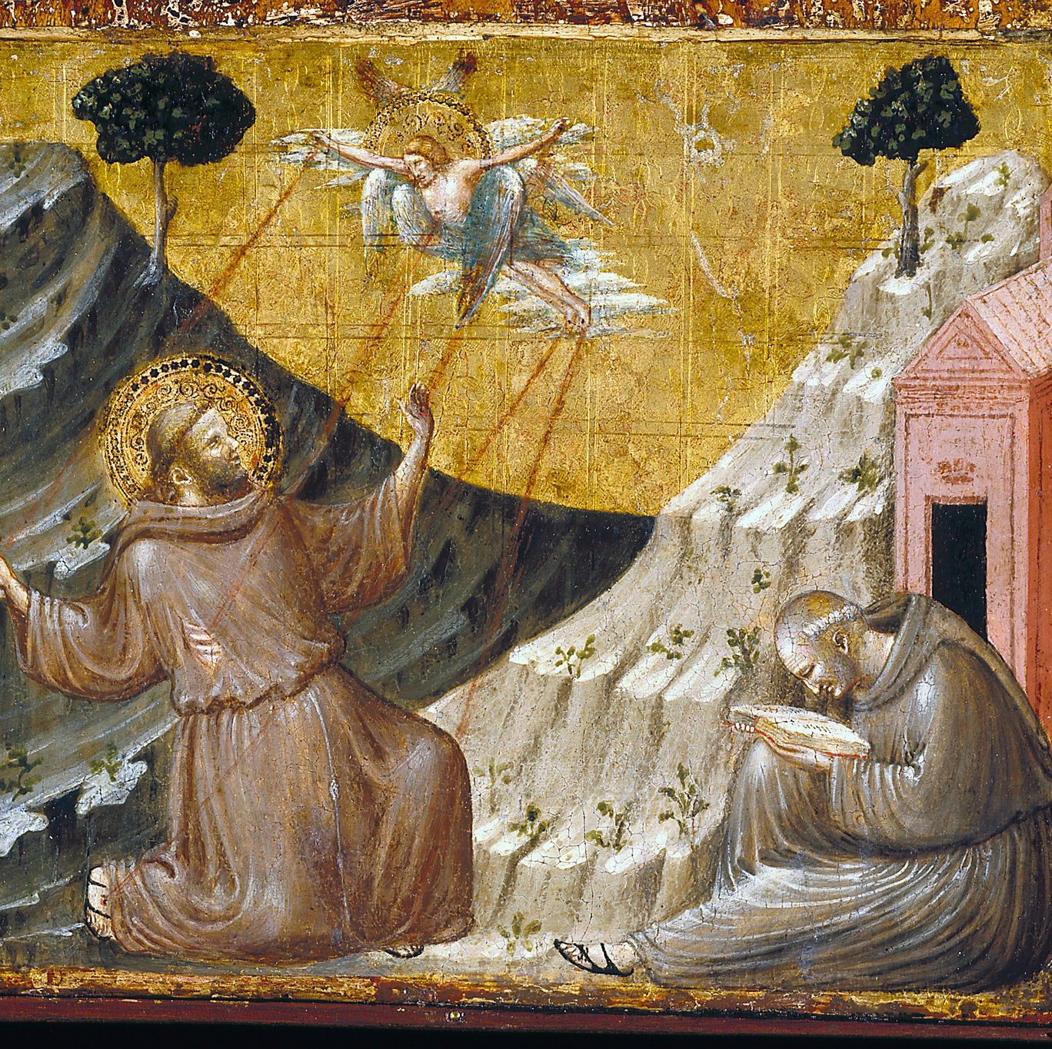
Stigmata & St. Francis of Assisi
Presented by: Emil Perosh
Notes:
Welcome everyone to today's presentation on a topic that blends the realms of spirituality, mysticism, and history: stigmata.
Today, we'll delve into the phenomenon of stigmata, with a special focus on one of the most famous figures associated with it, St. Francis of Assisi.

Slide 2
What is the Stigmata?
Stigmata refers to the spontaneous appearance of wounds on an individual's body, corresponding to the wounds of Jesus Christ during his crucifixion.
These wounds typically appear on the hands, feet, and side, mirroring the marks of the nails and spear in Jesus' crucifixion.

Slide 3
Theological Perspectives & Historical Background
The phenomenon of stigmata finds resonance in both Catholic doctrine and biblical tradition.
In paragraph 2014, the Catechism of the Catholic Church addresses the stigmata:
"Spiritual progress tends toward ever more intimate union with Christ. This union is called "mystical" because it participates in the mystery of Christ through the sacraments - "the holy mysteries" - and, in him, in the mystery of the Holy Trinity. God calls us all to this intimate union with him, even if the special graces or extraordinary signs of this mystical life are granted only to some for the sake of manifesting the gratuitous gift given to all.
St. Paul's letter to the Galatians (6:17) contains an intriguing passage where he states, "I bear on my body the marks of Jesus." While scholars debate the exact meaning of this passage, some interpret it as a reference to mystical experiences akin to the stigmata.
The concept of stigmata has its roots in Christian mysticism and has been reported in various saints throughout history.

Slide 4
St. Francis of Assisi
St. Francis of Assisi, born in Italy in 1181 or 1182, is one of the most revered saints in the Catholic Church.
He is renowned not only for receiving the stigmata but also for being the first recorded individual in history to bear the wounds of Christ.
Before the profound mystical experience of the stigmata, St. Francis underwent a remarkable transformation from a carefree youth to a devout and humble servant of God.
Initially known for his extravagant lifestyle and pursuit of worldly pleasures, St. Francis experienced a powerful conversion during his early twenties.
His encounter with lepers and a vision of Christ calling him to "rebuild my Church" ignited a radical change in his life.
Renouncing his wealth and embracing a life of poverty, St. Francis devoted himself to prayer, penance, and serving the poor.
He founded the Franciscan Order, emphasizing simplicity, humility, and compassion, and became known for his love of nature and all God's creatures.
St. Francis' holy life and unwavering commitment to following Christ, living the Gospels prepared him for the profound mystical experience of receiving the stigmata.

Slide 5
The Stigmata of St. Francis
The stigmata event of St. Francis is a pivotal moment in the history of Christian mysticism, marking a convergence of divine grace and human receptivity.
Accounts of this mystical event describe St. Francis as being in a state of ecstatic prayer atop Mount La Verna, seeking solitude to commune with God.
In this heightened state of spiritual awareness, St. Francis encountered a vision of a seraph, an angelic being, radiating with divine light and bearing the wounds of Christ.
The seraph's presence was overpowering, filling St. Francis with both awe and profound humility, as he beheld the sacred embodiment of Christ's suffering.
As the vision intensified, St. Francis experienced a profound merging of his own consciousness with the divine, transcending the boundaries of his physical being.
It was in this transcendent state that St. Francis felt the searing pain of the wounds of Christ imprinting themselves upon his body, marking him as a living testament to the crucified Savior.

Slide 6
The Stigmata of St. Francis (Continued)
The appearance of the stigmata was not merely a physical phenomenon but a spiritual reality, symbolizing St. Francis' deep union with Christ and his participation in the Paschal mystery.
These sacred wounds became a visible sign of St. Francis' profound spiritual journey, a journey marked by radical poverty, self-emptying love, and complete abandonment to the will of God.
The stigmata of St. Francis served as a powerful testament to the transformative power of divine grace and the capacity of the human soul to be united with the divine.
St. Francis' reception of the stigmata marked a profound moment of mystical communion, where the boundaries between the earthly and the divine dissolved, revealing the depths of God's love and the mystery of Christ's redemption.
The wounds of the stigmata were not just physical marks but embodied the spiritual reality of St. Francis' union with Christ's suffering and his participation in the salvific mission of Jesus.
This mystical experience deepened St. Francis' understanding of the redemptive power of Christ's sacrifice and fueled his zeal for spreading the message of love, humility, and reconciliation to all humanity.
The stigmata of St. Francis continues to inspire believers and mystics alike, serving as a tangible reminder of the transformative potential of encountering the divine in the depths of one's soul.

Slide 7
Scientific and Skeptical Perspectives
While the stigmata is viewed by many as a miraculous phenomenon, it has also been met with skepticism and scientific inquiry.
Some skeptics argue that stigmata may be psychosomatic or self-inflicted wounds, induced by intense religious fervor or psychological factors.
Scientific studies on stigmata have yielded inconclusive results, leaving the phenomenon open to interpretation and debate.

Slide 8
When evaluating claims of stigmata or other mystical phenomena, certain criteria are often considered to discern their authenticity:
Holiness and Virtue: The individual's character and reputation for holiness are assessed.
Lack of Self-Infliction: Investigators examine whether the wounds could have been self-inflicted or induced by natural causes.
Correlation with Religious Experience: The stigmata should be accompanied by other signs of spiritual fervor and religious devotion.
Medical Examination: Medical experts may analyze the wounds to determine their origin and nature.
Stigmatic Experiences of Others: Consistency with the experiences of other stigmatics throughout history is considered.
Miraculous Healings: Reports of miraculous healings associated with the stigmata can lend credence to its authenticity.
Lack of Motive for Deception: Investigators assess whether the individual had any motive or benefit for fabricating the stigmata.
Psychological Stability: The mental health and stability of the individual are evaluated to rule out psychosomatic causes.
Endurance of Wounds: The ability of the wounds to endure over time, without infection or medical intervention, is considered.
Consistency with Gospel Accounts: The wounds should correspond to the descriptions of Jesus' crucifixion in the Gospels.
Ecclesiastical Approval: Approval or recognition from religious authorities can validate the authenticity of the stigmata.
Impact on Witness and Community: The impact of the stigmata on witnesses and the wider community is taken into account.

Slide 9
Discerning Authenticity
The authenticity of stigmata experiences, such as that of St. Francis, is a subject of rigorous examination and scrutiny.
Contemporaneous accounts from reputable sources play a crucial role in establishing the authenticity of the phenomenon.
Witnesses, including fellow friars, clergy, and other contemporaries of St. Francis, documented the events surrounding the appearance of the stigmata with meticulous detail, providing valuable insight into the nature of the experience.
These eyewitness testimonies offer a firsthand perspective on the events, attesting to the sincerity and authenticity of St. Francis' mystical encounter.
Moreover, the credibility of these accounts is bolstered by the character and reputation of those who witnessed the stigmata. Many of these witnesses were individuals of deep faith and moral integrity, whose testimonies carry weight in evaluating the authenticity of the phenomenon.
In addition to eyewitness testimony, the consistency of St. Francis' stigmata with the accounts of other mystics and stigmatics throughout history lends further credence to its authenticity.
The wounds themselves, meticulously described by witnesses, were consistent with the traditional understanding of stigmata, appearing on the hands, feet, and side of St. Francis, mirroring the wounds of Christ.
Furthermore, the enduring impact of St. Francis' stigmata on the witness and community provides compelling evidence of its authenticity. The profound spiritual transformation experienced by St. Francis and the inspiration it evoked in others speak to the authenticity and transformative power of the phenomenon.
Ultimately, while the authenticity of stigmata experiences may be subject to debate and skepticism, the convergence of historical accounts, eyewitness testimonies, and the enduring spiritual legacy of individuals like St. Francis lends credence to the authenticity of these mystical phenomena.

Slide 10
Pope's Reflections on the 800th Anniversary
In 2024, the Catholic Church commemorated the 800th anniversary of St. Francis' reception of the stigmata, marking a significant milestone in the history of Christian spirituality.
Pope Francis, in his reflections on this auspicious occasion, offered profound insights into the enduring significance of St. Francis' life and spiritual legacy for believers around the world.
The Pope emphasized that St. Francis' reception of the stigmata was not merely an isolated event but a profound manifestation of his deep union with Christ and his radical embrace of the Gospel message.
St. Francis' encounter with the stigmata was a transformative moment that encapsulated the essence of his spiritual journey—a journey marked by radical humility, self-emptying love, and unwavering devotion to Christ.
Through the wounds of the stigmata, St. Francis became a living witness to the redemptive power of Christ's sacrifice, embodying the transformative love that lies at the heart of the Christian faith.
The Pope highlighted the enduring relevance of St. Francis' example in the modern world, where materialism, division, and indifference often obscure the true meaning of discipleship.
St. Francis' radical commitment to poverty, simplicity, and solidarity with the marginalized challenges contemporary believers to reevaluate their priorities and embrace a more authentic expression of Christian discipleship.
As the Church celebrated the 800th anniversary of St. Francis' stigmata, Pope Francis called on believers to rediscover the spirit of radical love and self-sacrifice embodied by St. Francis.
He urged the faithful to emulate St. Francis' example by embracing a life of humility, service, and compassion, particularly towards those on the margins of society.
In doing so, Pope Francis emphasized, believers can bear witness to the transformative power of the Gospel and contribute to the building of a more just, compassionate, and harmonious world.
Ultimately, the Pope's reflections on the 800th anniversary of St. Francis' stigmata served as a powerful reminder of the enduring relevance of St. Francis' message and the profound impact of his witness on the life of the Church and the world.

Slide 11
Significance and Interpretations
The stigmata of St. Francis transcends mere physical wounds; it embodies profound spiritual realities and theological significance.
St. Francis' reception of the stigmata is understood as a mystical union with the suffering of Christ, symbolizing his participation in the redemptive work of Jesus.
The wounds of the stigmata were not merely marks on his body but visible signs of his spiritual journey, reflecting the depth of his love for God and humanity.
St. Francis' stigmata is regarded as a divine gift, bestowed upon him as a sign of his extraordinary holiness and devotion to God.
For believers, the stigmata serves as a tangible reminder of Christ's sacrificial love and the transformative power of the Cross.
It challenges individuals to reflect on the meaning of suffering and to find hope and redemption in the midst of adversity.
The stigmata also invites believers to contemplate the mystery of Christ's presence in their own lives and to embrace a life of deeper prayer, humility, and service.
Throughout history, the stigmata of St. Francis has inspired devotion and reverence among believers, who see in him a model of radical discipleship and self-sacrificial love.
The significance of St. Francis' stigmata extends beyond the confines of religious tradition, resonating with people of diverse faith backgrounds and spiritual seekers alike.
As the Church commemorates the legacy of St. Francis and his reception of the stigmata, it calls believers to reflect on their own relationship with God and to respond with lives of faith, compassion, and solidarity with the marginalized.
Ultimately, the stigmata of St. Francis serves as a powerful symbol of God's presence in the world, inviting believers to encounter the divine in the midst of suffering and to embrace a spirituality of love, forgiveness, and reconciliation.

Slide 12
Legacy and Influence
The stigmata of St. Francis has left an indelible mark on the landscape of Christian spirituality, inspiring devotion, reflection, and theological inquiry for centuries.
St. Francis' reception of the stigmata marked a profound moment in the history of Christian mysticism, revealing the depths of divine love and the possibility of intimate communion with God.
His mystical experience continues to captivate the imagination of believers and scholars alike, inviting deeper exploration into the mysteries of faith and the transformative power of divine grace.
St. Francis' stigmata served as a catalyst for spiritual renewal and revival within the Church, inspiring countless individuals to embrace lives of holiness, simplicity, and service.
The Franciscan Order, founded by St. Francis, bears witness to the enduring legacy of his spiritual vision, promoting a spirituality grounded in poverty, humility, and solidarity with the marginalized.
St. Francis' emphasis on care for creation and reverence for all living beings continues to resonate in an age marked by environmental degradation and ecological crisis.
His example of radical love and compassion challenges believers to confront injustice and work for the transformation of society, echoing the prophetic call of the Gospel.
The stigmata of St. Francis serves as a powerful reminder of the transformative potential of encountering the divine in the depths of one's soul, inspiring believers to deepen their faith and commitment to following Christ.
As the Church commemorates the legacy of St. Francis and his reception of the stigmata, it calls believers to embrace the values of simplicity, humility, and love that characterized his life and ministry.
Ultimately, the legacy of St. Francis' stigmata endures as a beacon of hope and a testament to the enduring power of God's love to transform hearts and lives.

Slide 13
Conclusion
The authenticity criteria and historical evidence support the credibility of St. Francis' stigmata as a genuine mystical phenomenon.
Pope Francis's reflections underscore the continued relevance of St. Francis' example in the modern world.
As we reflect on St. Francis' life and legacy, may we be inspired to deepen our own faith and commitment to serving others with humility and love.
Thank you for your attention and may St. Francis’ commitment love of the Gospels and spirit of Love, compassion and peace guide us always.

Slide 14
THE LIFE OF SAINT FRANCIS OF ASSISI, Saint Bonaventure, Translated by E. Gurney Salter, 1904 by E.P. Dutton, New York, US. PUBLISHER www.eCatholic2000.com
https://www.usccb.org/news/2024/pope-marks-800th-anniversary-st-francis-assisis-stigmata
https://www.vatican.va/archive/ENG0015/__P71.HTM#-256
https://www.catholic.com/encyclopedia/mystical-stigmata
https://www.researchgate.net/publication/373867520_On_Stigmata_Suffering_and_Sanctity
https://aleteia.org/2015/01/08/what-are-the-stigmata-and-how-do-we-know-if-they-are-authentic/
https://www.dmfofs2.com/excerpts-from-the-first-life-of-st-francis-by-thomas-of-celano

