Slide 1
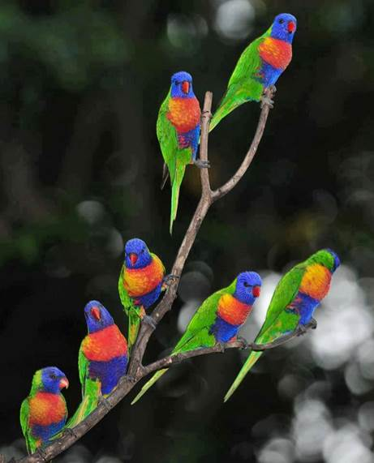
PRAISE GOD, WONDERFUL CREATOR!

Slide 2
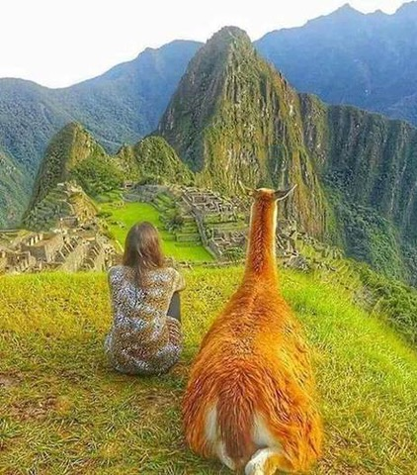
Glory be to the Father,
G

Slide 3
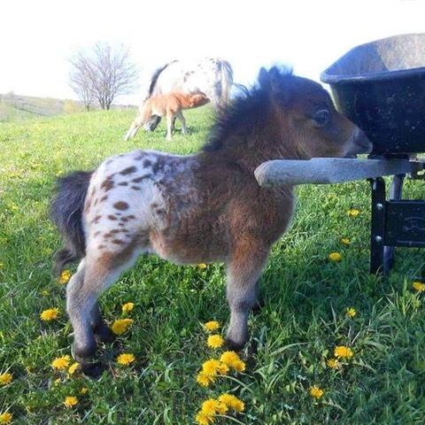
and to the Son,

Slide 4
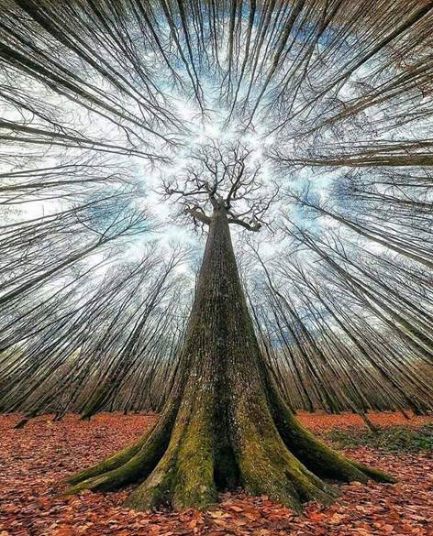
a
and to the Holy Spirit

Slide 5
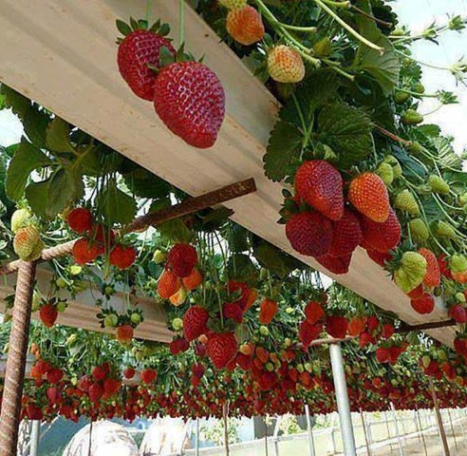
Praise God for the fruits of the earth.

Slide 6
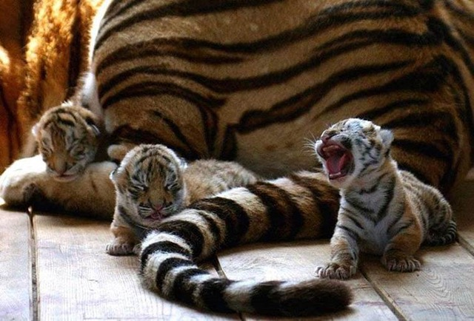
Praised be the Lord for beasts,
wild and tame,

Slide 7
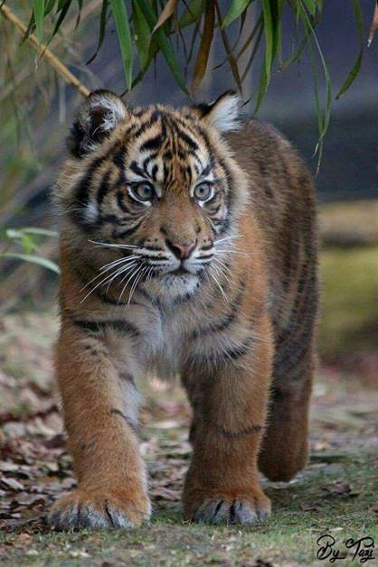
for wild tigers,

Slide 8
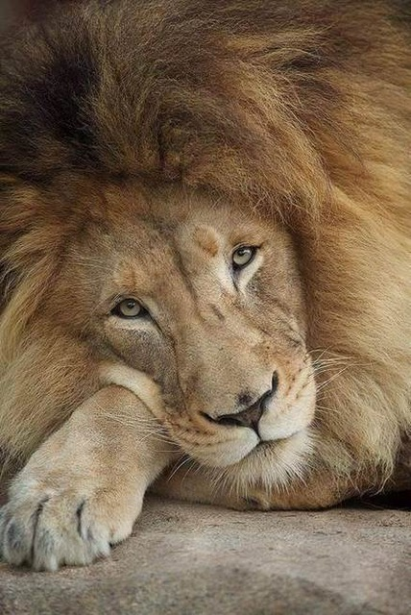
and for tame lions,

Slide 9
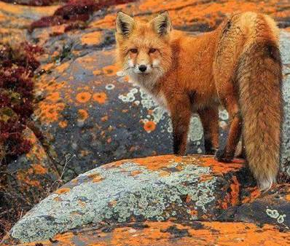
for wily foxes,

Slide 10
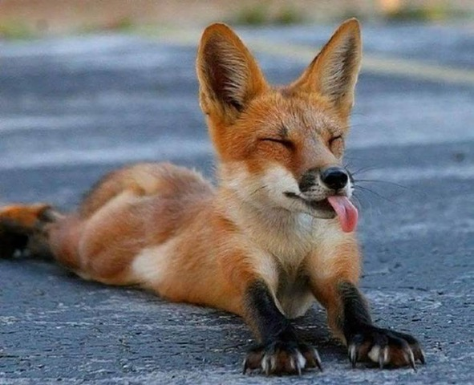
and for
cool foxes,

Slide 11
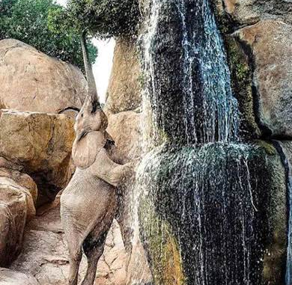
for greedy elephants,

Slide 12
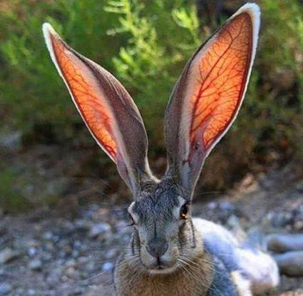
and for
rabbits,
all ears

Slide 13
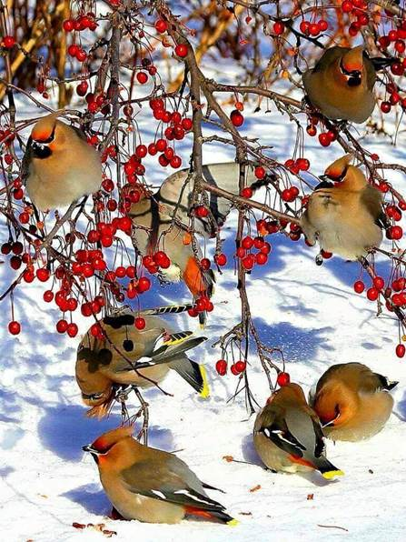
Praise the Lord for flocks of birds,

Slide 14
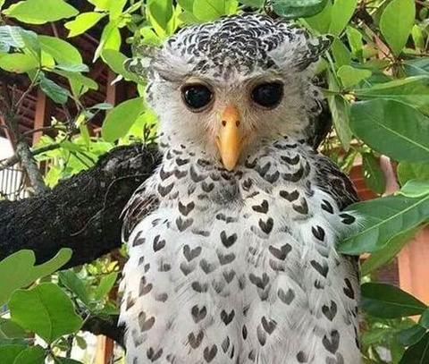
and for wise old owls,

Slide 15
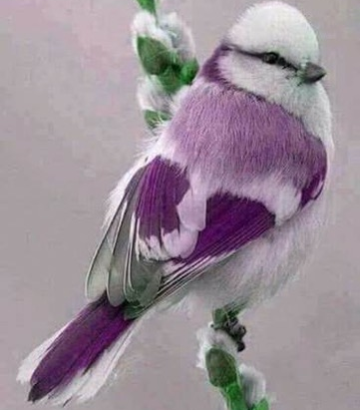
and tiny birds,

Slide 16
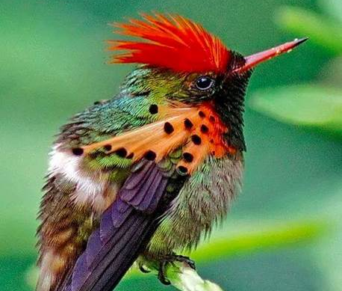
and colourful
birds.

Slide 17
Praise the Lord for splendid horses,

Slide 18
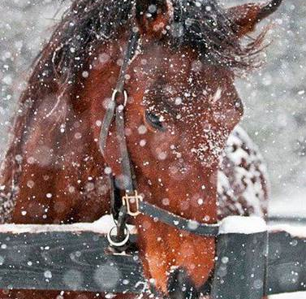
and for horses in winter,

Slide 19
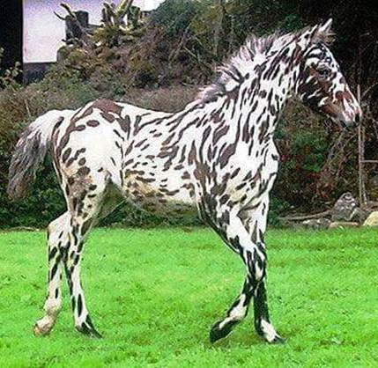
and for show ponies.

Slide 20
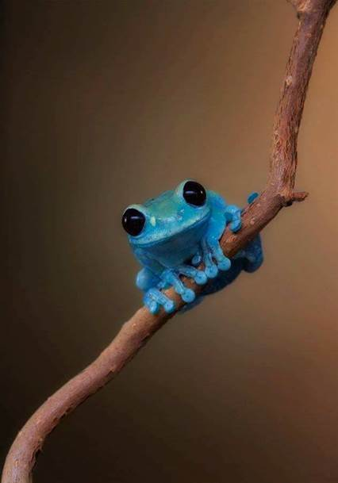
And for inquisitive frogs,
praise the Lord

Slide 21
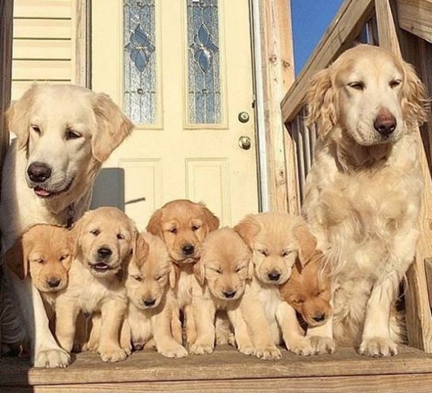
For dogs and puppies,
praise the Lord,

Slide 22
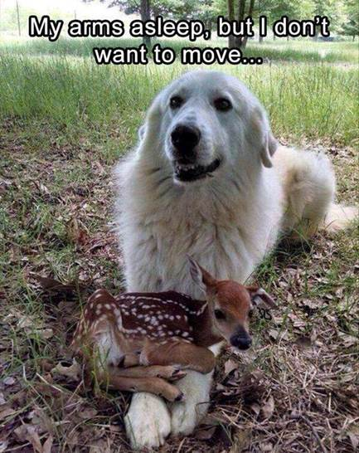
and for patient dogs.

Slide 23
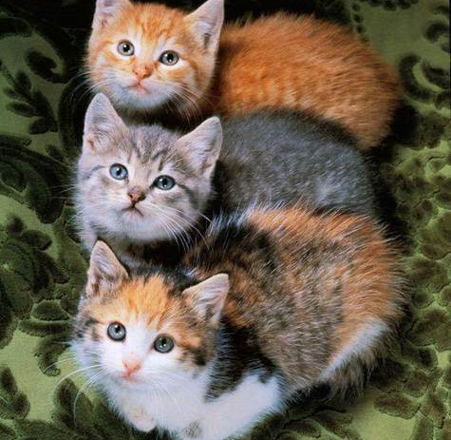
Praise the Lord for cats and kittens,

Slide 24
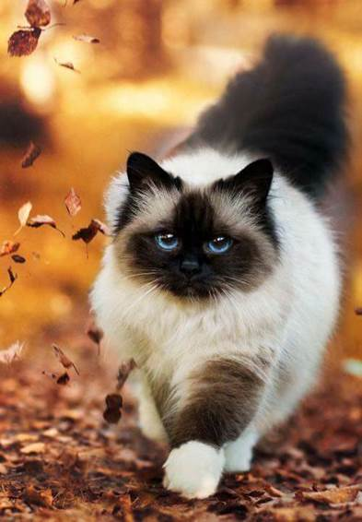
and for cats in control,

Slide 25
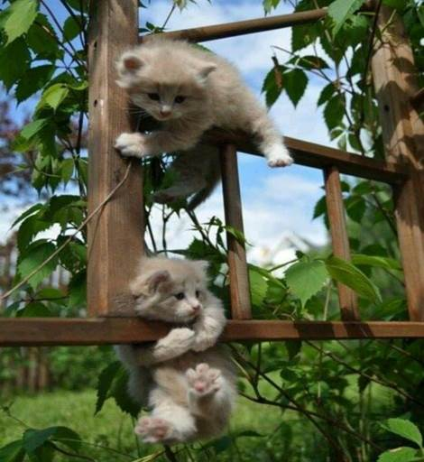
and for daredevil kittens,

Slide 26
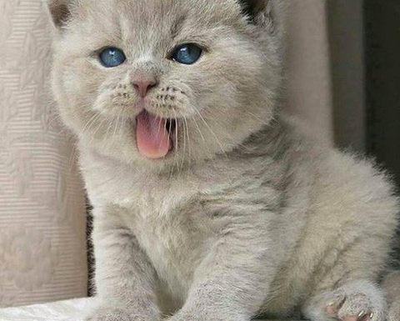
and for cuddly kittens.

Slide 27
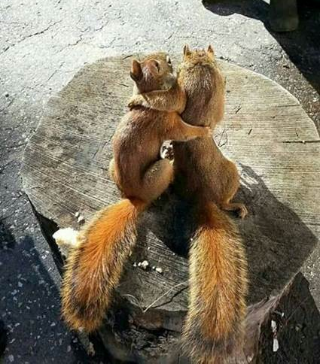
Praised be the Lord
for cosy friends

Slide 28
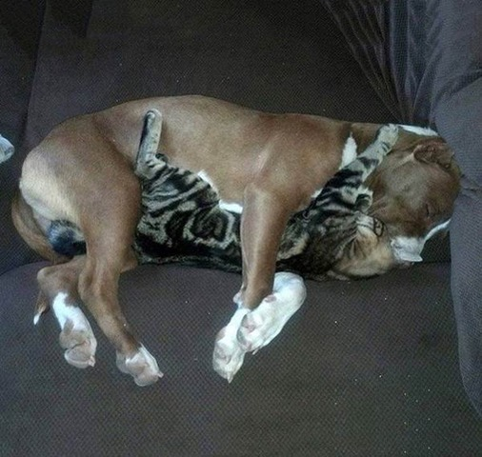
and for friendly rivals.

Slide 29
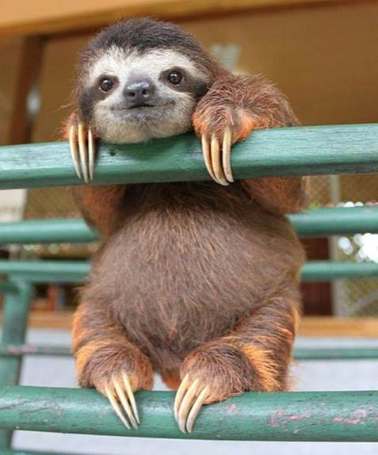
GOD BLESS YOU !

