Slide 1
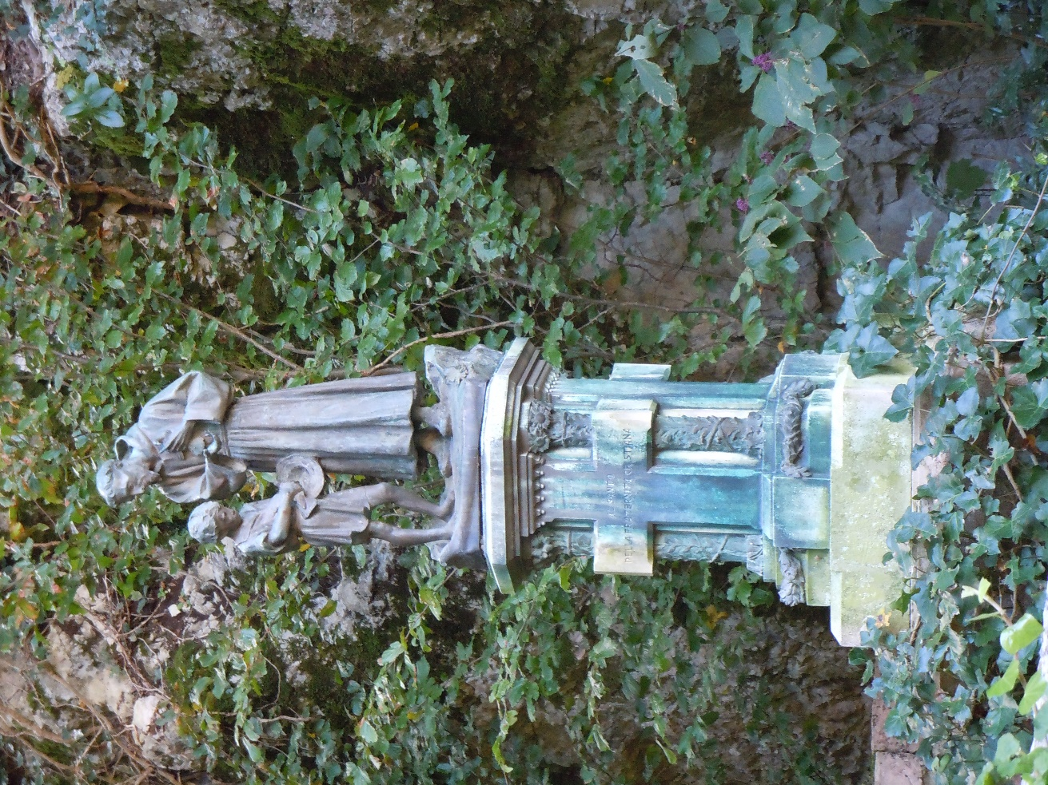
Aging
An Australian perspective
April 2017

Slide 2
Ageing
Context
The current situation
The challenge of maintaining an OFS presence in Australia

Slide 3
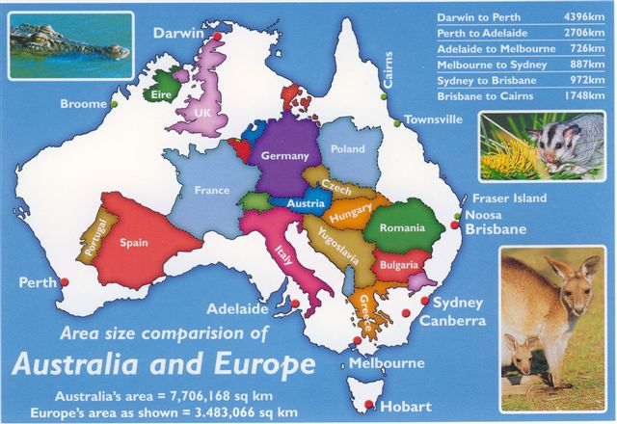

Slide 4
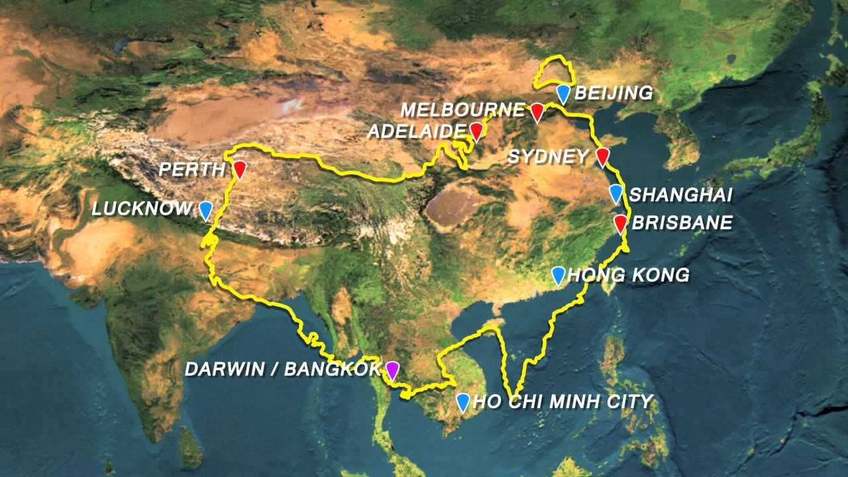

Slide 5
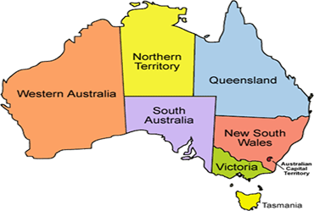
Australia
Area: 7.692 million sq kms
About 70% semi arid, arid or desert
Population: 24,127,200 (June 2016)
2013 – 66% live in cities along the coast

Slide 6
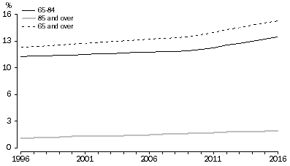
Proportion of population aged 65 years and over
1996 – 2016 People aged 65 and over increased from 12.% to 15.3%
This is projected to increase over the next decade.

Slide 7
Religion - Australia
61.1 % Christianity
22.3% No religion
9.4% Not stated or unclear
2.5% Buddhism
2.2% Islam
1.3% Hindu
1.2% Other Religions
2011 Census

Slide 8
RELIGION - Australia
March 2011
Christians 13,150,673
Catholics 5,439,268
Protestants 3,679,907

Slide 9
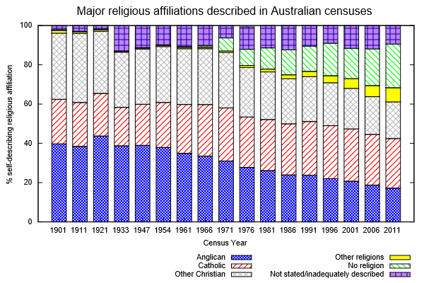

Slide 10
1901 – 2011
Increase in people who have no religion (green striped)
Increase in ‘other religions’ (yellow)
- immigration
3 Decrease in Christians including Catholics (red striped)

Slide 11
OFS OCEANIA – Demographics 2016
REGION | ACTIVE PROFESSED MEMBERS | INACTIVE PROFESSED MEMBERS | PEOPLE IN INITIAL FORMATION | NOS. SENT TO CIOFS | NO. OF FRATERNITIES
NSW/ACT | 175 | 65 | 18 | 240 | 14
VICTORIA | 52 | 36 | 12 | 88 | 4
QLD | 33 | 47 | 3 | 80 | 3
TAS | 9 | 10 | 0 | 19 | 2
SA | 53 | 14 | 2 | 67 | 3
WA | 40 | 62 | 3 | 102 | 2+1 provisional
Total | 362 | 234 | 38 | 596 | 28 +1 provisional

Slide 12
ACTIVE MEMBERS – AGE GROUPS
 | 18-30 | 30-50 | 50-70 | Over 70 | Total
NSW/ACT |  | 16 | 70 | 89 | 175
VICTORIA |  | 3 | 16 | 33 | 52
QLD |  | 3 | 4 | 26 | 33
TAS |  |  |  | 9 | 9
SA |  | 3 | 11 | 38 | 53
WA |  | 5 | 15 | 20 | 40
Total |  | 30 | 116 | 216 | 362

Slide 13
INACTIVE MEMBERS – AGE GROUPS
 | 18-30 | 30-50 | 50-70 | Over 70 | TOTAL
NSW/ACT |  | 1 | 13 | 51 | 65
VICTORIA |  | 1 | 2 | 33 | 36
QLD |  |  | 6 | 41 | 47
TAS |  |  |  | 10 | 10
SA |  | 2 | 2 | 10 | 14
WA |  |  | 7 | 56 | 62
Total |  | 4 | 30 | 200 | 234

Slide 14
PEOPLE IN INITIAL FORMATION – AGE GROUPS
 | 18-30 | 30-50 | 50-70 | Over 70 | TOTAL
NSW/ACT | 1 | 7 | 9 | 2 | 18
VICTORIA | 1 | 5 | 2 | 4 | 12
QLD |  | 1 | 2 |  | 3
TAS |  |  |  |  | 0
SA |  |  | 1 | 1 | 2
WA |  |  | 2 |  | 3
Total | 2 | 13 | 16 | 7 | 38

Slide 15
What has changed since the data was sent to CIOFS?
2 fraternities have gone into recess
5 Regions and not 6
2 people in initial formation have left
8 candidates have been professed
Anticipate that people going to their eternal rest
or becoming inactive

Slide 16
The challenge of maintaining the presence of the OFS in Australia

Slide 17
PROMOTION
of the
Secular Franciscan Order
is vital for us to survive

Slide 18
St Clare
“Among the other gifts that we have received and continue to receive from our magnanimous father of Mercies and for which we must express our deepest thanks to our glorious God, there is our vocation, which the more perfect and the greater it is, the more we are indebted to Him …..…;
Recognise your vocation. The son of God has become for us the way that our blessed father Francis, His true lover and imitator, has shown and taught us by example.”

Slide 19
The great gift given in our Franciscan vocation challenges us to go out and invite others to come and see

Slide 20
GC Article 45;
The promotion of vocations to the Order is a duty of all the brothers and sisters and is a sign of the vitality of the fraternities themselves. The brothers and sisters, convinced of the validity of the Franciscan way of life, should pray that God may give them the grace of the Franciscan vocation to new the members.

Slide 21
GC 45
2 Although nothing can substitute for the witness of each member of the fraternity, the councils must adopt appropriate means to promote the secular Franciscan vocation

Slide 22
In Australia we have
1 amended our National Statutes to include an elected Promotions Officer and a role description
(currently with Juridical Council)
2 ALL Regions and local fraternities have an elected Promotions Officer

Slide 23
Promotion Days
are for all the Fraternity
personal invitations are given and poster invitations are placed in churches.
it is necessary to create a Franciscan atmosphere
sharing of our Spirituality
personal testimonies are given
we love and minister to each individual
celebration of our life and charism.

Slide 24
Must keep ageing Fraternities alive
Requires a strong commitment from each member.
See the value of the aging members have the experience of life.
Encourage diversity by having fraternities with different cultural backgrounds eg Italian, Croation, Korean
Nurture and encourage enquirers.
;

Slide 25
Goals need to be:
Bring awareness of the OFS and it role in the Church to the world
Promote any inspirational role models we have in our Fraternities
Reach out to those within our Church who may have a vocation to the Secular Franciscan Order.
Encourage younger people to be involved

Slide 26
Strategies for achieving these goals
Internet and Social Media
Website www.ofsaustralia.org.au includes
- contact us details (Most of inquiries through ‘contact us’ are seeking more information about order)
- vocational information
- resources for children
Facebook page

Slide 27
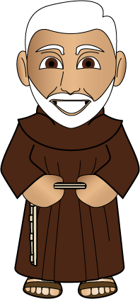
2 Other strategies to be explored:
You tube, twitter etc
Local Catholic media
- diocesan newspapers, parish newsletters etc
Working with Franciscan friars

Slide 28
Promotional materials including
windcheaters, Tshirts, hats with OFS logo or “Franciscan” phrase, slogan
Promotional resource materials to use at presentations – brochures, powerpoints,
Resources for children – cartoons, stories, colouring in pictures etc

Slide 29
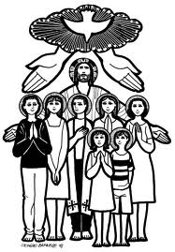
LOCAL FRATERNITES
Places of
prayer and communion
friendship
vibrant fraternity
Meetings
glow with fraternal spirit of St Francis
come alive with the grace of the Gospel

Slide 30
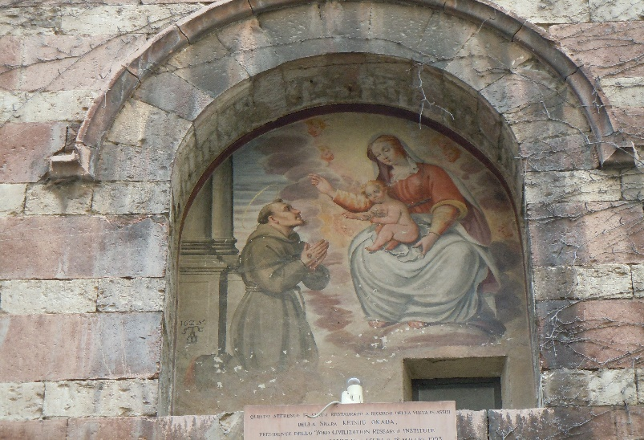
Jesus is the core of Franciscan spirituality
Living the Gospel
Sharing
Fraternity life
Ongoing formation
Deep personal relationship with Jesus and his Blessed Mother

Slide 31
Local Fraternity is the cornerstone of the Secular Franciscan Order
Core of our charism
Friendship/fraternity
Prayer/contemplation

Slide 32
contemplation ↔ GOD ↔ fraternity

Slide 33
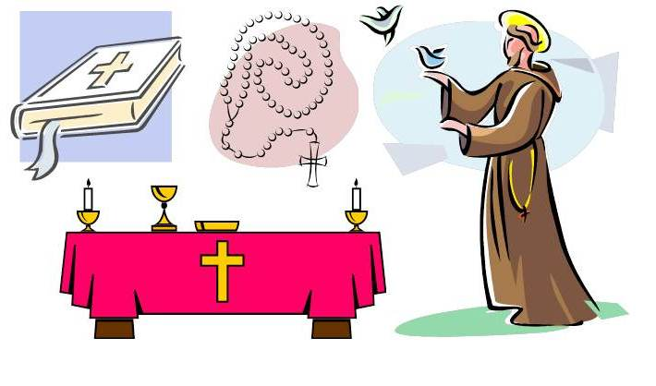
Liturgy of the Church and Fraternity
The Mass
The Sacraments
Divine Office
sustains our life in God

Slide 34
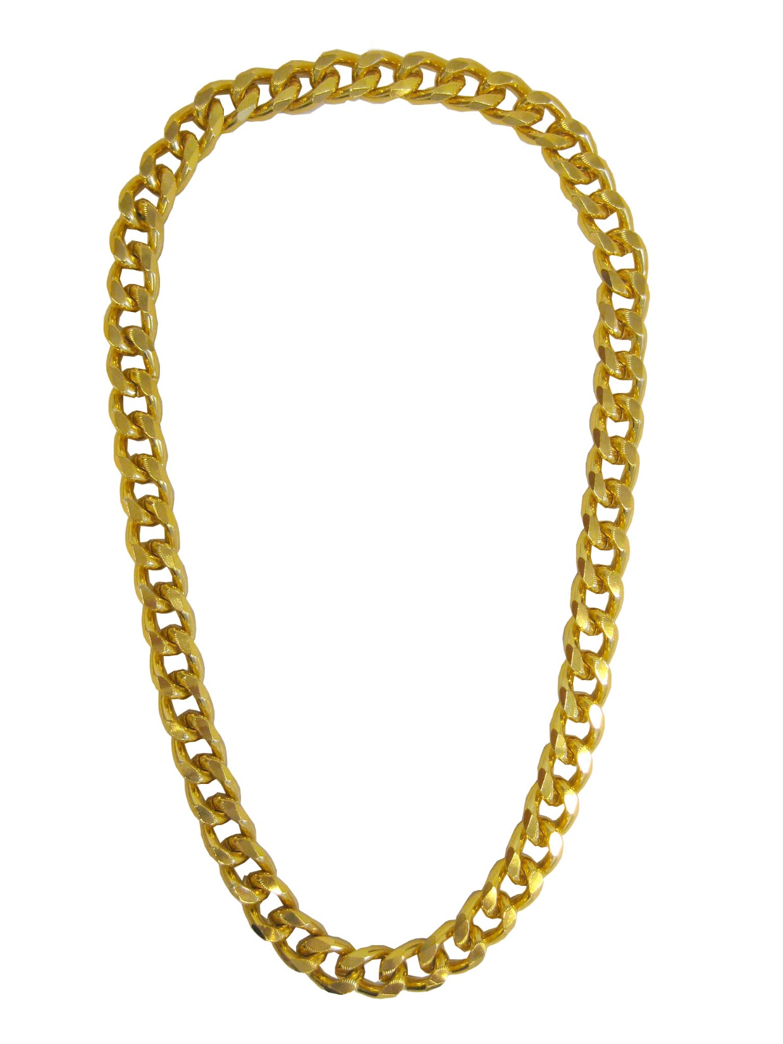
Each fraternity is part of a world wide lay Order
Each fraternity is a link in a golden chain.
If one link is weak then the whole chain is weakened.

Slide 35
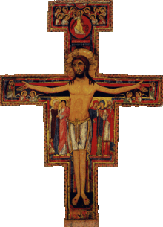
If we are vibrant, positive, inviting and strong in our Franciscan spirituality
Then we can reach out and
SHARE OUR JOURNEY AND OUR DREAM

